Slide 1
Project Topics

Slide 2
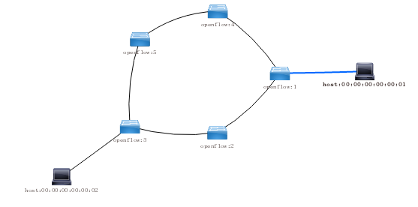
Fast Path Recovery
Controller

Slide 3
Traffic Load Balance with OpenFlow
Controller

Slide 4
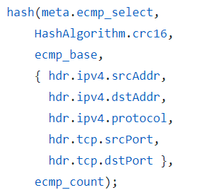
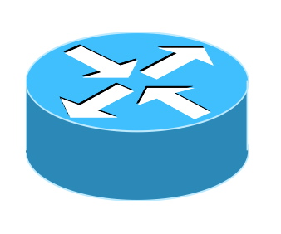
Traffic Load Balance with P4
Controller
50%
30%
20%

Slide 5

Unicast
Video services via unicast suffer from high server and network load
Keep one connection for each client → high server load
Each stream occupy bandwidth→ high network load

Slide 6
Multicast
Multicast reduces the load of both servers and networks
Support more clients with the same resources
The load of the server is reduced
More clients can be served
The load of the network is reduced

Slide 7

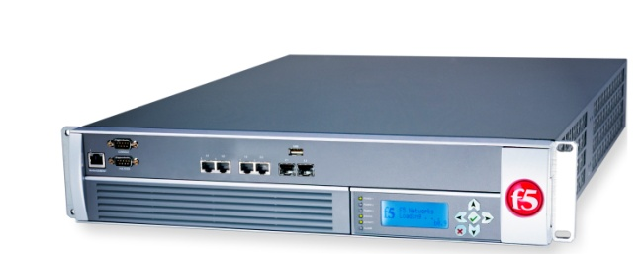



Scaling NFV
Satisfy performance SLAs
Minimize operating costs
Accurately monitor traffic
CPU
Packet loss

Slide 8
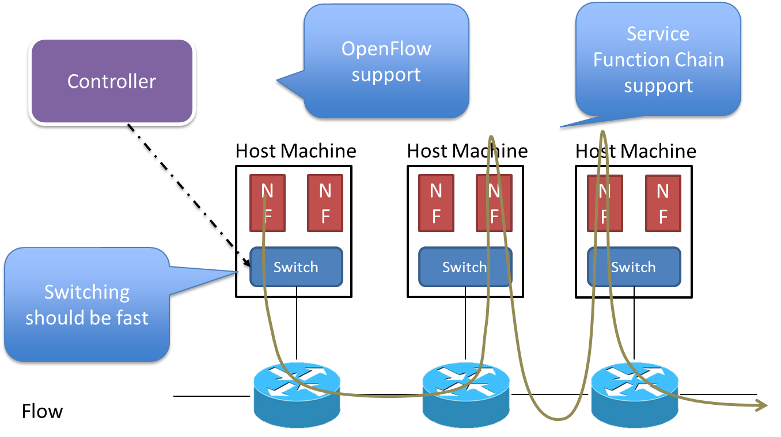
Service Function Chains
The traffic should go through multiple functions as a chain in high speed
OpenDaylight + OpenStack can support SFC
Deploy it and show it is working

Slide 9
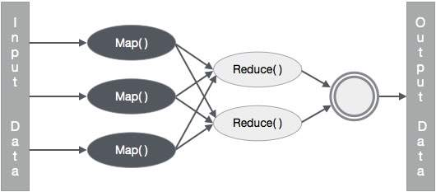
Parallel Computing
Map reduce

